Slide 2
Introduction to SQL DW
Nithesh Krishnappa

Slide 3
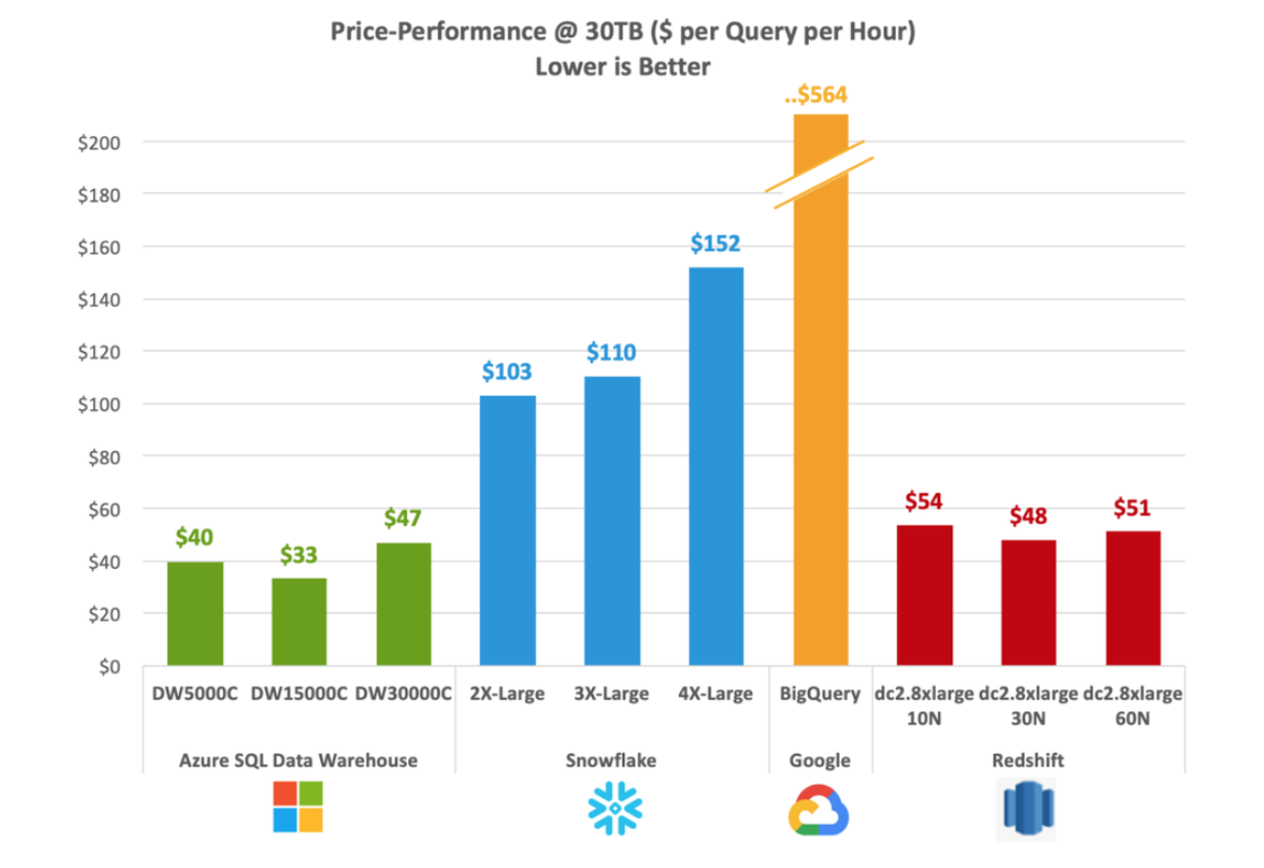
Industry-leading price performance
Price-Performance @ 30TB ($ per Query per Hour)
(Lower is Better)
Notes:
From Gigaom Cloud DW Benchmark in November 2018, on the TPC-H 30TB benchmark

Slide 4
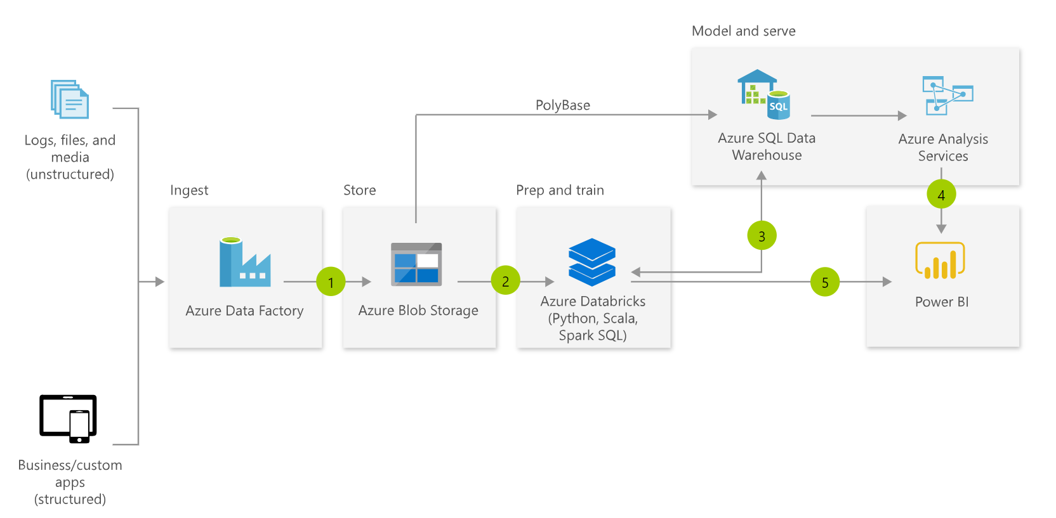
Typical MDW Architecture
Notes:
Fully managed

Slide 5
Changes in Data Warehouse space
Integration with unstructured data
Drive to the cloud
Hardware renewal
Support costs
SQL

Slide 6



Introducing Azure SQL DW Service
A relational data warehouse-as-a-service, fully managed by Microsoft.
Industries first elastic cloud data warehouse with proven SQL Server capabilities.
Support your smallest to your largest data storage needs.
Elastic scale & performance
Market Leading Price & Performance
Powered by the Cloud
Azure
Azure
Get started in minutes
Integrated with Azure ML, PowerBI & ADF
Scales beyond petabytes of data
Cloud DW Scale-out Processing
Instant-on compute scales in seconds
Query Relational / Non-Relational
Saas
Simple billing compute & storage
Pay for what you need, when you need it with dynamic pause
Azure
Office 365
Office 365
Public
Cloud

Slide 7
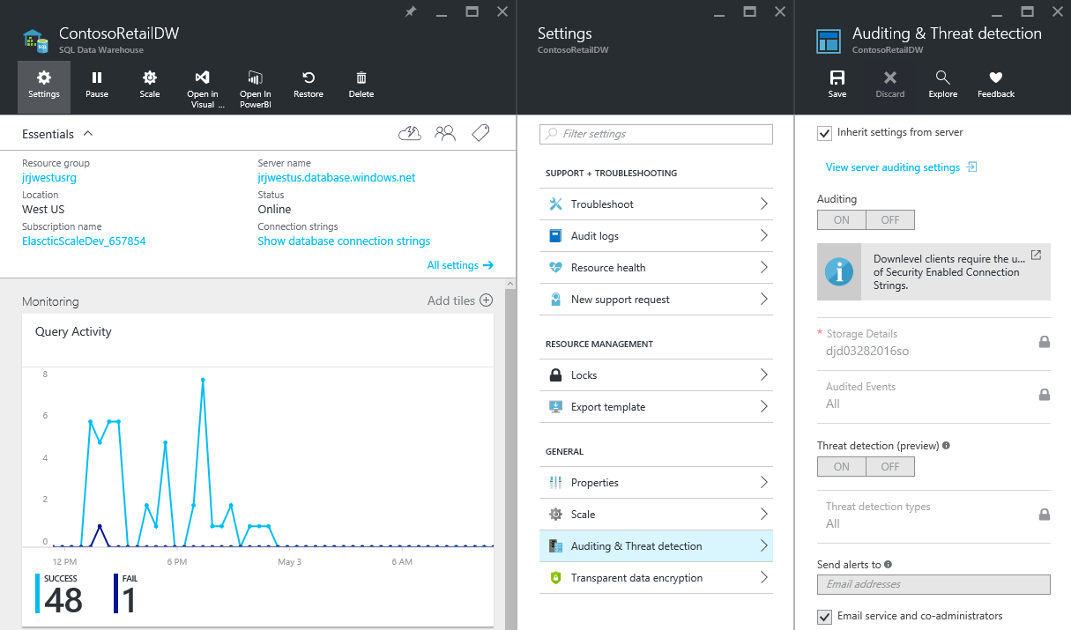
Fully managed PaaS
Notes:
Fully managed

Slide 8
Suitable workloads
Analytics
Store large volumes of data.
Consolidate disparate data into a single location.
Shape, model, transform and aggregate data.
Perform query analysis across large datasets.
Ad-hoc reporting across large data volumes.
All using simple SQL constructs.
“SQL on SQL”

Slide 9
Unsuitable workloads
Operational workloads (OLTP)
High frequency reads and writes.
Large numbers of singleton selects.
High volumes of single row inserts.
SQL
Data Preparation
Row by row processing needs.
Incompatible formats (JSON, XML).
SQL

Slide 10
Base Patterns

Slide 11






Resume / Pause Pattern
Persist
Export
Query
Stream
Import
Import
Resume
Ingest
Aggregate
Export
Pause
Lower Cost
High Concurrency
“Dashboard Query”
Notes:
Red Stars
Archive on the way in to the warehouse
Geo-redundant blob storage guarantees your data
Allows for RPO 0 Data Warehouse architectures
Allows for point in time restart-ability of ELT
Resume / Pause Pattern

Slide 12

SaaS customer isolation
DWU 200
DWU 600
Customer
Clickstream
Corporate
DWU 1200
Notes:
Red Stars
Consistent single view of raw data held in Blob Storage accessible by all consumers of data
Customer specific DWU settings allowing for simple chargeback models

Slide 13


Big Data & SQLDW
Unknown Value Data
XML
High Value Data
JSON
TEXT
Model
Load
Transform
Aggregate
Consume
Data Preparation
Pre-process
Transpose
Re-format
Batch
Ad-hoc
Batch

Slide 14
Under the hood - Architecture

Slide 15
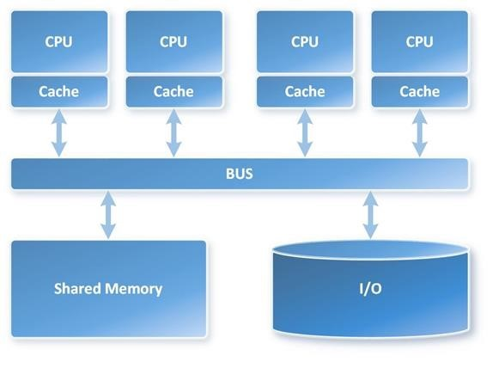
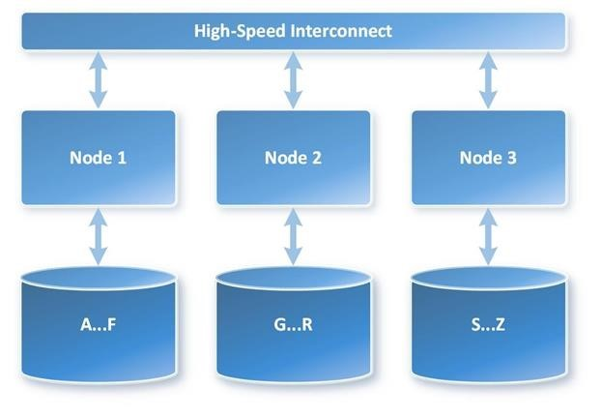
SMP vs. MPP Architecture
VS
Notes:
Symmetric Multi-Processing (SMP)
Massively Parallel Processing (MPP)
In a shared nothing architecture, there is no single point of contention across the system and nodes do not share memory or disk storage. Data is horizontally partitioned across nodes, such that each node has a subset of rows from each table in the database. Each node then processes only the rows on its own disks. Systems based on this architecture can achieve massive scale as there is no single bottleneck to slow down the system

Slide 16
SQL DW Fundamentals
Control
Control
Connection and tool endpoint. Coordinates compute activity.
Engine
DMS
SQL DB
Compute
Handles query processing, ability to scale up/down
Compute
Compute
Compute
Compute
DMS
DMS
DMS
DMS
SQL DB
SQL DB
SQL DB
SQL DB
Dist_DB_1
Dist_DB_2
Dist_DB_15
Dist_DB_16
Dist_DB_17
Dist_DB_30
Dist_DB_31
Dist_DB_32
Dist_DB_45
Dist_DB_46
Dist_DB_47
Dist_DB_60
DMS: Data Movement Services
Coordinates data movement between nodes
…
…
…
…
Azure Blob Storage
Storage
Remote storage. Scales independently of compute
Notes:
Compute Node VM hosting two key components of SQL DW.
These two key SQL DB and DMS.
DMS, stands for Data Movement Service
cover more later on why move data
SQL DB crunching the data and DMS moving
Third component to SQL DW, the Engine.
primary function is to optimize and manage incoming work.
Engine parses and creates query plans.
Compute node has several SQL databases.
MPP
60 databases equally divided
This example is DW500, each compute node is hosting 12 databases.
Let’s say we want to take this DW500 and scale it up to a DW1000
What happens behind the scenes?
(1) take all of the SQL Databases down, (2) add 5 more compute nodes
(3) start up the SQL DB databases again.
some of the databases are on different compute nodes
6 distributions per node rather than 12
Each Node has half the work now

Slide 17
Data Warehouse Units
DWU
100
200
300
400
500
600
1000
1200
1500
2000
3000
6000
…
30000
Normalized amount of compute
Converts to billing units i.e. what you pay
CPU
RAM
I/O
DWU

Slide 18

Separate compute from storage
SQL
Control
Compute
Premium Storage
Notes:
De-coupled storage from compute & control
Completely elastic
Pay for the data you store and the compute you provision

Slide 19
Independently scale compute
SQL
Control
Compute
Premium Storage
Notes:
De-coupled storage from compute & control
Completely elastic
Pay for the data you store and the compute you provision

Slide 20
Pause and resume workload
SQL
Control
Compute
Premium Storage
Notes:
De-coupled storage from compute & control
Completely elastic
Pay for the data you store and the compute you provision

Slide 21
Gen 2 Compute and Memory
Performance level | Compute nodes | Distributions per Compute node | Memory per data warehouse (GB)
DW100c | 1 | 60 | 60
DW200c | 1 | 60 | 120
DW300c | 1 | 60 | 180
DW400c | 1 | 60 | 240
DW500c | 1 | 60 | 300
DW1000c | 2 | 30 | 600
DW1500c | 3 | 20 | 900
DW2000c | 4 | 15 | 1200
DW2500c | 5 | 12 | 1500
DW3000c | 6 | 10 | 1800
DW5000c | 10 | 6 | 3000
DW6000c | 12 | 5 | 3600
DW7500c | 15 | 4 | 4500
DW10000c | 20 | 3 | 6000
DW15000c | 30 | 2 | 9000
DW30000c | 60 | 1 | 18000

Slide 22


Management Interfaces
 | Portal | PowerShell | Rest API | T-SQL
Create
Pause and resume
Scale
Rest API

Slide 23
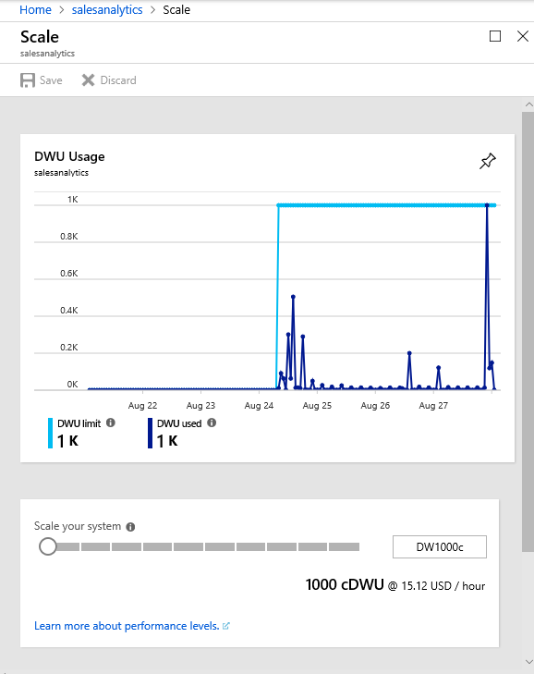
Scaling in the Portal

Slide 24
Scaling via T-SQL and PowerShell
T-SQL
ALTER DATABASE ContosoRetailDW
MODIFY (service_objective = 'DW100');
PowerShell
Set-AzureRmSqlDatabase `
–ResourceGroupName "RG_name" `
–ServerName "SRV_name" `
–DatabaseName "DB_name" `
-RequestedServiceObjectiveName "DW1000"

Slide 25
Query Execution
Result
Query
SQL
Control
Compute
Premium Storage
Notes:
De-coupled storage from compute & control
Completely elastic
Pay for the data you store and the compute you provision

Slide 26
Data Distribution

Slide 27
Table Distribution Options
Hash Distributed
Round Robin
(Default)
Replicated
Data divided across nodes based on hashing algorithm
Same value will always hash to same distribution
Single column only
Data distributed evenly across nodes
Easy place to start, don’t need to know anything about the data
Simplicity at a cost
Data repeated on every node
Simplifies many query plans and reduces data movement
Best with joining hash table
Check for Data Skew, NULLS, -1
Will incur more data movement at query time
Consumes more space
Joining two Replicated Table runs
on one node

Slide 28
Creating tables
CREATE TABLE [dbo].[DimStore]
(
[StoreKey] int NOT NULL
, [GeographyKey] int NOT NULL
, [StoreName] nvarchar(100) NOT NULL
, [StoreType] nvarchar(15) NULL
, [StoreDescription] nvarchar(300) NOT NULL
, [Status] nvarchar(20) NOT NULL
, [OpenDate] datetime NOT NULL
, [CloseDate] datetime NULL
, [ETLLoadID] int NULL
, [LoadDate] datetime NULL
, [UpdateDate] datetime NULL
)
WITH
( CLUSTERED INDEX([StoreKey])
, DISTRIBUTION = ROUND_ROBIN
)
;
CREATE TABLE [dbo].[FactOnlineSales]
(
[OnlineSalesKey] int NOT NULL
, [DateKey] datetime NOT NULL
, [StoreKey] int NOT NULL
, [ProductKey] int NOT NULL
, [PromotionKey] int NOT NULL
, [CurrencyKey] int NOT NULL
, [CustomerKey] int NOT NULL
, [SalesOrderNumber] nvarchar(20) NOT NULL
, [SalesOrderLineNumber] int NULL
, [SalesQuantity] int NOT NULL
, [SalesAmount] money NOT NULL
)
WITH
( CLUSTERED COLUMNSTORE INDEX
, DISTRIBUTION = HASH([ProductKey])
)
;
Row
Column
Distribution

Slide 29
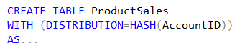
Hash Distributed
Dist_1
ProductSales – Raw Data
Dist_2
AccountID | SalesAmt | …
47 | $1,234.36 | …
36 | $2,345.47 | …
14 | $3,456.58 | …
25 | $4,567.69 | …
48 | $5,678.70 | …
37 | $6,789.81 | …
… | … | …
47 | $1,234.36 | …
Dist_3
36 | $2,345.47 | …
Hash(47)
Hash(36)
14 | $3,456.58 | …
Dist_4
25 | $4,567.69 | …
48 | $5,678.70 | …
37 | $6,789.81 | …
Dist_5
…
Dist_N

Slide 30
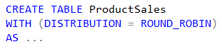
Round Robin Distributed
Dist_1
ProductSales – Raw Data
Dist_2
AccountID | SalesAmt | …
47 | $1,234.36 | …
36 | $2,345.47 | …
14 | $3,456.58 | …
25 | $4,567.69 | …
48 | $5,678.70 | …
37 | $6,789.81 | …
42 | $1,632.25 | …
88 | $4,453.21 | …
52 | $7,892.81 | ...
91 | $9,549.64 | …
66 | $2,498.14 | …
23 | $3,145.99 | …
47 | $1,234.36 | …
Dist_3
36 | $2,345.47 | …
14 | $3,456.58 | …
Dist_4
25 | $4,567.69 | …
48 | $5,678.70 | …
37 | $6,789.81 | …
Dist_5
42 | $1,632.25 | …
…
88 | $4,453.21 | …
Dist_N
52 | $7,892.81 | …
91 | $9,549.64 | …
66 | $2,498.14 | …
23 | $3,145.99 | …
Notes:
Default

Slide 31
Replicated Tables

Slide 32
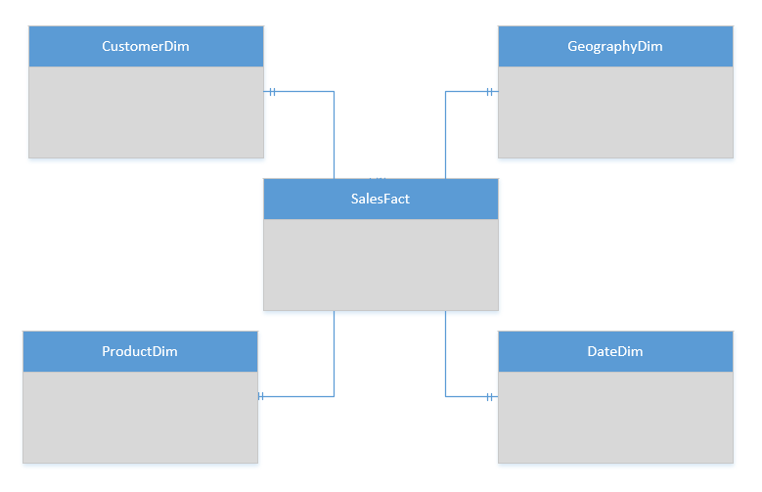
Replicated Table Scenarios
Scenarios to consider using Replicated tables:
Star schema reporting
Dimensions – descriptive entities about fact data
ETL master data, common domain data used during transaction loading

Slide 33
T-SQL: Create a Replicated table
CREATE TABLE dbo.DimCustomer
( CustomerKey int NOT NULL
, GeographyKey int NULL
, CustomerAlternateKey nvarchar(15) NOT NULL
, Title nvarchar(8) NULL
, FirstName nvarchar(50) NULL
, LastName nvarchar(50) NULL
, BirthDate date NULL
, Gender nvarchar(1) NULL
, EmailAddress nvarchar(50) NULL
, YearlyIncome money NULL
, DateFirstPurchase date NULL
)
WITH
( CLUSTERED COLUMNSTORE INDEX
, DISTRIBUTION = REPLICATED
)

Slide 34

Replicated Tables… How it works
Compute Node 1
RR Table
RR Table
RR Table
RR Table
Cache Build Request
Replication Cache Manager
Repl Table
Distribution_1
Distribution_2
Distribution_3
Distribution_4
Compute Node 2
CREATE
CREATE
SELECT
SELECT
UPDATE
UPDATE
RR Table
RR Table
RR Table
RR Table
Repl Table
Distribution_5
Distribution_6
Distribution_7
Distribution_8
Notes:
WHY A CACHE? – TO ACHIEVE ELASTICITY
With GA, the replicated table cache is no longer built as a step in the query plan during the runtime of the query. A select against a replicated table without a cache built submits a request to build the cache to the replication cache manager, asynchronously and is resolved immediately against the round robin table. The cache manager has a simple queueing mechanism and immediately builds the cache.

Slide 35
Common table distribution methods
Table Category | Recommended Distribution Option
Fact | Use hash-distribution with clustered columnstore index. Performance improves because hashing enables the platform to localize certain operations within the node itself during query execution. Operations that benefit: COUNT(DISTINCT( <hashed_key> )) OVER PARTITION BY <hashed_key> JOIN ON <hashed_key>
Dimension | Use replicated for smaller tables. If tables are too large to store on each Compute node, use hash-distributed.
Staging | Use round-robin for the staging table. The load with CTAS is faster. Once the data is in the staging table, use INSERT…SELECT to move the data to production tables.

Slide 36
Tables – Indexes
Clustered columnstore (Default primary)
Highest level of data compression
Best overall query performance
Clustered index (Primary)
Performant for looking up a single to few rows
Heap (Primary)
Faster loading and landing temporary data
Best for small lookup tables
Nonclustered indexes (secondary)
Enable ordering of multiple columns in a table
Allows multiple nonclustered on a single table
More performant lookup queries
CREATE TABLE myTable
(
id int NOT NULL,
lastName varchar(20),
zipCode varchar(6)
)
WITH (
CLUSTERED COLUMNSTORE INDEX
/*
HEAP
CLUSTERED INDEX (id)
*/
);
-- Add non-clustered index
CREATE INDEX zipCodeIndex ON myTable (zipCode);
Notes:
Clustered columnstore indexes
By default, SQL Data Warehouse creates a clustered columnstore index when no index options are specified on a table. Clustered columnstore tables offer both the highest level of data compression as well as the best overall query performance. Clustered columnstore tables will generally outperform clustered index or heap tables and are usually the best choice for large tables. For these reasons, clustered columnstore is the best place to start when you are unsure of how to index your table.
There are a few scenarios where clustered columnstore may not be a good option:
Columnstore tables do not support varchar(max), nvarchar(max) and varbinary(max). Consider heap or clustered index instead.
Columnstore tables may be less efficient for transient data. Consider heap and perhaps even temporary tables.
Small tables with less than 100 million rows. Consider heap tables.
Clustered and nonclustered indexes
Clustered indexes may outperform clustered columnstore tables when a single row needs to be quickly retrieved. For queries where a single or very few row lookup is required to performance with extreme speed, consider a cluster index or nonclustered secondary index. The disadvantage to using a clustered index is that only queries that benefit are the ones that use a highly selective filter on the clustered index column. To improve filter on other columns a nonclustered index can be added to other columns. However, each index which is added to a table adds both space and processing time to loads.
Heap tables
When you are temporarily landing data on SQL Data Warehouse, you may find that using a heap table makes the overall process faster. This is because loads to heaps are faster than to index tables and in some cases the subsequent read can be done from cache. If you are loading data only to stage it before running more transformations, loading the table to heap table is much faster than loading the data to a clustered columnstore table. In addition, loading data to a temporary table loads faster than loading a table to permanent storage.
For small lookup tables, less than 100 million rows, often heap tables make sense. Cluster columnstore tables begin to achieve optimal compression once there is more than 100 million rows.
Source: https://docs.microsoft.com/en-us/azure/sql-data-warehouse/sql-data-warehouse-tables-index

Slide 37
Row Store & Column Store

Slide 38
Column store taxonomy
Data
Row Group
Segments
Column store
2034857,23552534,26262569085923458958294582342-52935-2385349085295-25894-589245-285928592-5845829582-58258295849058-28592-58294582405982948529058409589584590285902859204582945825982058958290582945082905825-2502-45905-93245,vitoortkgldkggjwov j4o534585-0348565920345234059=3405943=-5923405=23950345923=509235=239560235932=46942306496046940693=46043693b069,hb05,b6905869347 87-987g89-9s8g-89-89 89-89-89mg89wer-t8t9et8-t-=8349652-=856=8=98t0e=t9e0t=e9t09=90=39560=659450693=565096=35695=69305=69,vw06=62=96069,b]si5=96292500000-2034857,23552534,26262569085923458958294582342-52935-2385349085295-25894-589245-285928592-5845829582-58258295849058-28592-58294582405982948529058409589584590285902859204582945825982058958290582945082905825-2502-45905-93245,vitoortkgldkg vlgjwov j4o534585-0348565920345234059=3405943=-5923405=23950345923=509235=239560235932=46942306496046940693=46043693b069,hb05,b6905869347 87-987g89-9s8g-89-89 89-89-89mg89wer-t8t9et8-t-=8349652-=856=8=98t0e=t9e0t=e9t09=90=39560=659450693=565096=35695=69305=69,vw06=62=96069,b]si5=96292500000-2034857,23552534,26262569085923458958294582342-52935-2385349085295-25894-589245-285928592-5845829582-58258295849058-28592-582945824059829485290584095892034857,23552534,26262569085923458958294582342-52935-2385349085295-25894-589245-285928592-5845829582-58258295849058-28592-58294582405982948529058409589584590285902859204582945825982058958290582945082905825-2502-45905-93245,vitoortkgldkggjwov j4o534585-0348565920345234059=3405943=-5923405=23950345923=509235=239560235932=46942306496046940693=46043693b069,hb05,b6905869347 87-987g89-9s8g-89-89 89-89-89mg89wer-t8t9et8-t-=8349652-=856=8=98t0e=t9e0t=e9t09=90=39560=659450693=565096=35695=69305=69,vw06=62=96069,b]si5=96292500000-2034857,23552534,26262569085923458958294582342-52935-2385349085295-25894-589245-285928592-5845829582-58258295849058-28592-58294582405982948529058409589584590285902859204582945825982058958290582945082905825-2502-45905-93245,vitoortkgldkg vlgjwov j4o534585-0348565920345234059=3405943=-5923405=23950345923=509235=239560235932=46942306496046940693=46043693b069,hb05,b6905869347 87-987g89-9s8g-89-89 89-89-89mg89wer-t8t9et8-t-=8349652-=856=8=98t0e=t9e0t=e9t09=90=39560=659450693=565096=35695=69305=69,vw06=62=96069,b]si5=96292500000-2034857,23552534,26262569085923458958294582342-52935-2385349085295-25894-589245-285928592-5845829582-58258295849058-28592-58294582405982948529058409589
2034857,23552534,26262569085923458958294582342-52935-2385349085295-25894-589245-285928592-5845829582-58258295849058-28592-58294582405982948529058409589584590285902859204582945825982058958290582945082905825-2502-45905-93245,vitoortkgldkggjwov j4o534585-0348565920345234059=3405943=-5923405=23950345923=509235=239560235932=46942306496046940693=46043693b069,hb05,b6905869347 87-987g89-9s8g-89-89 89-89-89mg89wer-t8t9et8-t-=8349652-=856=8=98t0e=t9e0t=e9t09=90=39560=659450693=565096=35695=69305=69,vw06=62=96069,b]si5=96292500000-2034857,23552534,26262569085923458958294582342-52935-2385349085295-25894-589245-285928592-5845829582-58258295849058-28592-58294582405982948529058409589584590285902859204582945825982058958290582945082905825-2502-45905-93245,vitoortkgldkg vlgjwov j4o534585-0348565920345234059=3405943=-5923405=23950345923=509235=239560235932=46942306496046940693=46043693b069,hb05,b6905869347 87-987g89-9s8g-89-89 89-89-89mg89wer-t8t9et8-t-=8349652-=856=8=98t0e=t9e0t=e9t09=90=39560=659450693=565096=35695=69305=69,vw06=62=96069,b]si5=96292500000-2034857,23552534,26262569085923458958294582342-52935-2385349085295-25894-589245-285928592-5845829582-58258295849058-28592-582945824059829485290584095892034857,23552534,26262569085923458958294
2034857,23552534,26262569085923458958294582342-52935-2385349085295-25894-589245-285928592-5845829582-58258295849058-28592-58294582405982948529058409589584590285902859204582945825982058958290582945082905825-2502-45905-93245,vitoortkgldkggjwov j4o534585-0348565920345234059=3405943=-5923405=23950345923=509235=239560235932=46942306496046940693=46043693b069,hb05,b6905869347 87-987g89-9s8g-89-89 89-89-89mg89wer-t8t9et8-t-=8349652-=856=8=98t0e=t9e0t=e9t09=90=39560=659450693=565096=35695=69305=69,vw06=62=96069,b]si5=96292500000-2034857,23552534,26262569085923458958294582342-52935-2385349085295-25894-589245-285928592-5845829582-58258295849058-28592-58294582405982948529058409589584590285902859204582945825982058958290582945082905825-2502-45905-93245,vitoortkgldkg vlgjwov j4o534585-0348565920345234059=3405943=-5923405=23950345923=509235=239560235932=46942306496046940693=46043693b069,hb05,b6905869347 87-987g89-9s8g-89-89 89-89-89mg89wer-t8t9et8-t-=8349652-=856=8=98t0e=t9e0t=e9t09=90=39560=659450693=565096=35695=69305=69,vw06=62=96069,b]si5=96292500000-2034857,23552534,26262569085923458958294582342-52935-2385349085295-25894-589245-285928592-5845829582-58258295849058-28592-582945824059829485290584095892034857,23552534,26262569085923458958294
Notes:
These are partition aligned rowgroups. If you have a partition, you will get a rowgroup per partition.
If the partitions are too small, then you won’t have very many rowgroups in each partition and performance will slow.

Slide 39
Scale out = Distributed tables
ROW STORE
COLUMN STORE

Slide 40
Row store or Column store?
Small Data Set (< 60 million rows)
Frequent updates
Small Dimension tables
Large Data Set (> 60 million rows)
Mostly append only data
Fact tables or large dimension tables
Row store
Column store

Slide 41
Clustered columnstore indexes
There are a few scenarios where clustered column store may not be a good option:
Column store tables do not support varchar(max), nvarchar(max) and varbinary(max). Consider heap or clustered index instead.
Column store tables may be less efficient for transient data. Consider heap and perhaps even temporary tables.
Small tables with less than 60 million rows. Consider heap tables.
Optimizing CCI
https://docs.microsoft.com/en-us/azure/sql-data-warehouse/sql-data-warehouse-tables-index#optimizing-clustered-columnstore-indexes

Slide 42
Tables – Partitions
Overview
Table partitions divide data into smaller groups
In most cases, partitions are created on a date column
Supported on all table types
Benefits
Improves efficiency and performance of loading and querying by limiting the scope to subset of data.
Offers significant query performance enhancements where filtering on the partition key can eliminate unnecessary scans and eliminate IO.
CREATE TABLE [dbo].[FactInternetSales]
(
[ProductKey] int NOT NULL,
[OrderDateKey] int NOT NULL,
[CustomerKey] int NOT NULL,
[PromotionKey] int NOT NULL,
[SalesOrderNumber] nvarchar(20) NOT NULL,
[OrderQuantity] smallint NOT NULL,
[UnitPrice] money NOT NULL,
[SalesAmount] money NOT NULL
)
WITH
(
CLUSTERED COLUMNSTORE INDEX,
DISTRIBUTION = HASH([ProductKey]),
PARTITION (
[OrderDateKey] RANGE RIGHT FOR VALUES (
20000101,20010101,20020101,20030101,20040101,20050101
)
)
);
Notes:
What are table partitions?
Table partitions enable you to divide your data into smaller groups of data. In most cases, table partitions are created on a date column. Partitioning is supported on all SQL Data Warehouse table types; including clustered columnstore, clustered index, and heap. Partitioning is also supported on all distribution types, including both hash or round robin distributed.
Partitioning can benefit data maintenance and query performance. Whether it benefits both or just one is dependent on how data is loaded and whether the same column can be used for both purposes, since partitioning can only be done on one column.
Benefits to loads
The primary benefit of partitioning in SQL Data Warehouse is to improve the efficiency and performance of loading data by use of partition deletion, switching and merging. In most cases data is partitioned on a date column that is closely tied to the order in which the data is loaded into the database. One of the greatest benefits of using partitions to maintain data it the avoidance of transaction logging. While simply inserting, updating, or deleting data can be the most straightforward approach, with a little thought and effort, using partitioning during your load process can substantially improve performance.
Partition switching can be used to quickly remove or replace a section of a table. For example, a sales fact table might contain just data for the past 36 months. At the end of every month, the oldest month of sales data is deleted from the table. This data could be deleted by using a delete statement to delete the data for the oldest month. However, deleting a large amount of data row-by-row with a delete statement can take too much time, as well as create the risk of large transactions that take a long time to rollback if something goes wrong. A more optimal approach is to drop the oldest partition of data. Where deleting the individual rows could take hours, deleting an entire partition could take seconds.
Benefits to queries
Partitioning can also be used to improve query performance. A query that applies a filter to partitioned data can limit the scan to only the qualifying partitions. This method of filtering can avoid a full table scan and only scan a smaller subset of data. With the introduction of clustered columnstore indexes, the predicate elimination performance benefits are less beneficial, but in some cases there can be a benefit to queries. For example, if the sales fact table is partitioned into 36 months using the sales date field, then queries that filter on the sale date can skip searching in partitions that don’t match the filter.
Sizing partitions
While partitioning can be used to improve performance some scenarios, creating a table with too many partitions can hurt performance under some circumstances. These concerns are especially true for clustered columnstore tables. For partitioning to be helpful, it is important to understand when to use partitioning and the number of partitions to create. There is no hard fast rule as to how many partitions are too many, it depends on your data and how many partitions you loading simultaneously. A successful partitioning scheme usually has tens to hundreds of partitions, not thousands.
When creating partitions on clustered columnstore tables, it is important to consider how many rows belong to each partition. For optimal compression and performance of clustered columnstore tables, a minimum of 1 million rows per distribution and partition is needed. Before partitions are created, SQL Data Warehouse already divides each table into 60 distributed databases. Any partitioning added to a table is in addition to the distributions created behind the scenes. Using this example, if the sales fact table contained 36 monthly partitions, and given that SQL Data Warehouse has 60 distributions, then the sales fact table should contain 60 million rows per month, or 2.1 billion rows when all months are populated. If a table contains fewer than the recommended minimum number of rows per partition, consider using fewer partitions in order to increase the number of rows per partition. For more information, see the Indexing article, which includes queries that can assess the quality of cluster columnstore indexes.
Source: https://docs.microsoft.com/en-us/azure/sql-data-warehouse/sql-data-warehouse-tables-partition

Slide 43
Data Loading

Slide 44
Data Loading
Polybase and T-SQL
ADF – (with Polybase)
SSIS – (with Polybase)
BCP
3rd Party tools

Slide 45
WHAT does PolyBase do?
Load Data
Use external tables as an ETL tool to cleanse data before loading
Age-out Data
Age data to HDFS or Azure Storage as ‘cold’ but query-able.
Interactively Query
Analyze relational and non-relational data together
HOW does it do it?
Imposes structure on semi-structured data
Define external tables over data
Reads/Writes Hadoop file formats
Text, CSV, RCFILE, ORC, Parquet, Avro, etc.
Parallelizes Data Transfers
Direct loads to service compute nodes

Slide 46
Parallel Load
Compute Node
Azure Storage Blob (ASB)
DMS
Bridge
Control Node
Compute Node
DMS
DMS
Bridge
Compute Node
DMS
Bridge
Notes:
BCP and SSIS come through the “front-door” Control Node

Slide 47
Polybase – authentication
Overview
The credentials used for Polybase queries are stored in the data warehouse
Credentials encrypted with a symmetric key entered by the user during setup.
-- Create master key to encrypt credential secret
CREATE MASTER KEY ENCRYPTION BY PASSWORD = 'S0me!nfo';
-- Create database scoped credential for Azure Data Lake Store Gen2 (required if not using managed service identity)
CREATE DATABASE SCOPED CREDENTIAL AzureStorageCredential
WITH IDENTITY = 'user', Secret = '<storage_account_key>’;

Slide 48
Polybase – external file access
Overview
Polybase supports querying files stored in a Hadoop File System (HDFS), Azure Blob storage, or Azure Data Lake Store.
To query files, users create three objects: External data source, external file format, external table.
-- Create Azure DataLake Gen2 Storage reference
CREATE EXTERNAL DATA SOURCE AzureStorage with
(
TYPE = HADOOP, LOCATION=‘abfss://<containername>@<storageaccount>.blob.core.windows.net',
CREDENTIAL = AzureStorageCredential
);
-- Type of format in Hadoop (CSV, RCFILE , ORC, PARQUET).
CREATE EXTERNAL FILE FORMAT TextFileFormat WITH
(
FORMAT_TYPE = DELIMITEDTEXT,
FORMAT_OPTIONS (FIELD_TERMINATOR ='|', USE_TYPE_DEFAULT = TRUE)
)
-- LOCATION: path to file or directory that contains data
CREATE EXTERNAL TABLE [dbo].[CarSensor_Data]
(
[SensorKey] int NOT NULL,
[Speed] float NOT NULL,
[YearMeasured] int NOT NULL
)
WITH (LOCATION='/Demo/’, DATA_SOURCE = AzureStorage, FILE_FORMAT = TextFileFormat
);

Slide 49
Create table as select (CTAS)
Overview
The CTAS statement is a parallel operation that creates a new table based on the output of a SELECT statement.
Can also be used for column transformation
Ex: Change varchar size or transform datetime
Benefit
Simplest and fastest way to create a copy of a table.
Allows for ingesting data stored in an external source into managed data warehouse tables.
Redistribute tables for optimal performance (create hash-distributed or replicated tables)
-- Ingest external table data into data warehouse
CREATE TABLE [dbo].[FactInternetSales]
WITH
(
DISTRIBUTION = ROUND_ROBIN
, CLUSTERED COLUMNSTORE INDEX
)
AS
SELECT *
FROM [staging].[FactInternetSales]
;

Slide 50
Copy command
Overview
Simplifies loading data into data warehouse.
Accesses directly from external sources
Data Lake Store Gen 2
Blob Storage
Highly parallelized, scales with cluster compute.
No dependency on managed objects such as external tables.
--Create destination table in SQL DW
CREATE TABLE [dbo].[weatherTable]
(
[ObservationTypeCode] [nvarchar](5) NOT NULL,
[ObservationTypeName] [nvarchar](100) NOT NULL,
[ObservationUnits] [nvarchar](5) NULL
)
WITH (
DISTRIBUTION = ROUND_ROBIN, HEAP);
--Copy files in parallel directly into datawarehouse table
COPY INTO [dbo].[weatherTable]
FROM 'abfss://<storageaccount>.blob.core.windows.net/<filepath>'
WITH (
FILE_FORMAT = 'DELIMITEDTEXT’,
SECRET = CredentialObject);

Slide 51
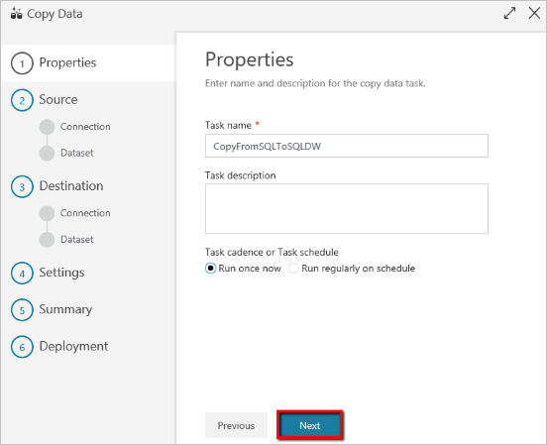
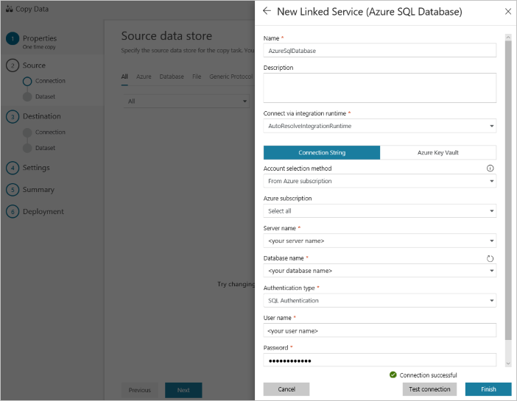
Azure Data Factory Copy Data tool
Overview
The Azure Data Factory Copy Data tool provides an intuitive wizard that allows you to copy data from a variety of data sources into Azure SQL Data Warehouse.

Slide 52

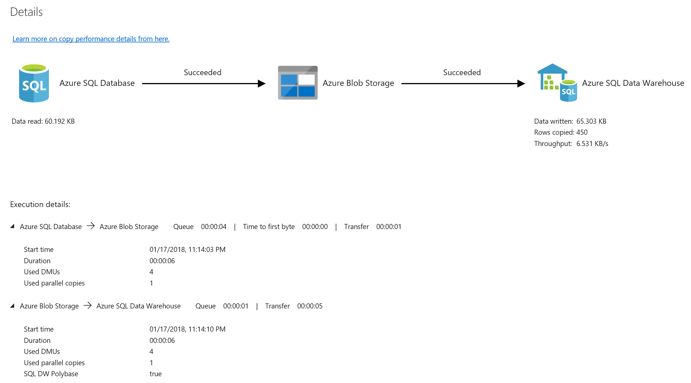
Azure Data Factory Copy activity
Overview
The Azure Data Factory Copy activity allows copying to and from Azure SQL Data Warehouse from any supported data store.
The Copy activity also supports retrieving data from a SQL source by using a SQL query or stored procedure. Authentication can be via:
SQL Authentication
Service principal token authentication
Managed identity token authentication

Slide 53
Databricks – structured streaming
Overview
The Databricks SQL DW connector supports batch and structured streaming support for writing real-time data into Azure SQL Data Warehouse.
It uses Polybase and the Databricks structured streaming API to stream data from Kafka or Kinesis sources directly into SQL Data Warehouse at a user-configurable rate.
# Prepare streaming source; this could be Kafka, Kinesis, or a simple rate stream.
df = spark.readStream \
.format("rate") \
.option("rowsPerSecond", "100000") \
.option("numPartitions", "16") \
.load()
# Apply some transformations to the data then use
# Structured Streaming API to continuously write the data to a table in SQL DW.
df.writeStream \
.format("com.databricks.spark.sqldw") \
.option("url", <azure-sqldw-jdbc-url>) \
.option("tempDir", "wasbs://<containername>@<storageaccount>.blob.core.windows.net/<directory>") \
.option("forwardSparkAzureStorageCredentials", "true") \
.option("dbTable", <table-name>) \
.option("checkpointLocation", "/tmp_location") \
.start()
Source: https://docs.azuredatabricks.net/spark/latest/data-sources/azure/sql-data-warehouse.html#streaming-support

Slide 54
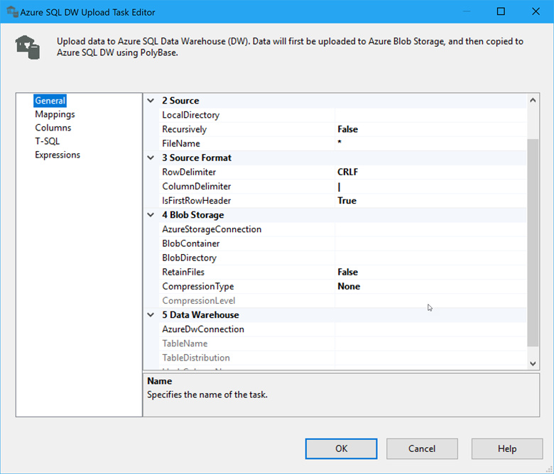
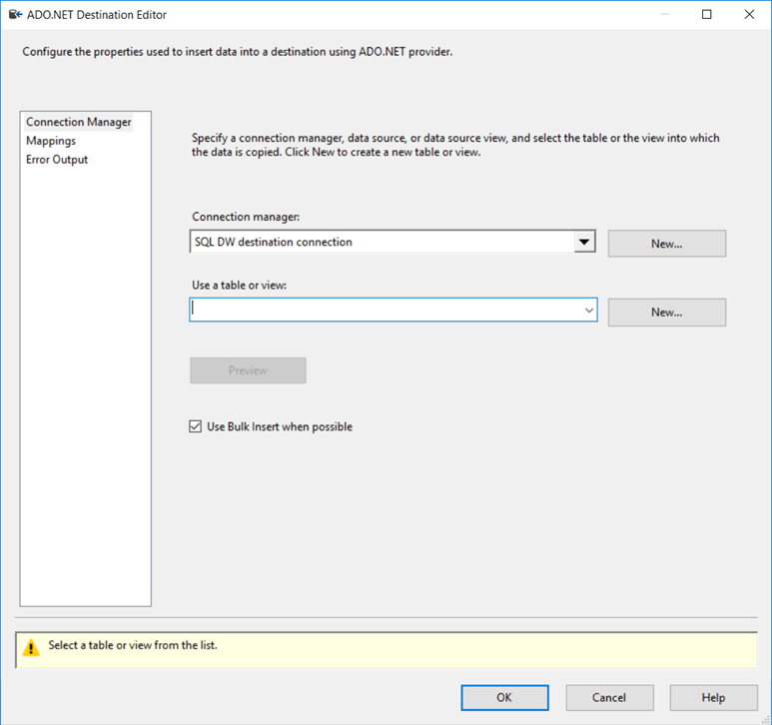
SQL Server Integration Services (SSIS)
Overview
SQL Server Integration Services is used to extract, transform data and load data from a variety of sources into Azure SQL Data Warehouse.
There are two options for loading data into SQL Data Warehouse with SSIS:
Azure SQL Data Warehouse Upload Task: provides best performance but assumes source data is in delimited text file format.
Data Flow Task: slower than SQL Data Warehouse Upload Task but supports a wider range of data sources.

Slide 55
Workload Management

Slide 56
Resource classes
Overview
Pre-determined resource limits defined for a user or role.
Govern the system memory assigned to each query.
Effectively used to control the number of concurrent queries that can run on a data warehouse.
Exemptions to concurrency limit:
CREATE|ALTER|DROP (TABLE|USER|PROCEDURE|VIEW|LOGIN)
CREATE|UPDATE|DROP (STATISTICS|INDEX)
INSERT VALUES
SELECT from system views and DMVs
EXPLAIN
/* View resource classes in the data warehouse */
SELECT name
FROM sys.database_principals
WHERE name LIKE '%rc%' AND type_desc = 'DATABASE_ROLE';
/* Change user’s resource class to 'largerc' */
EXEC sp_addrolemember 'largerc', 'loaduser’;
/* Decrease the loading user's resource class */
EXEC sp_droprolemember 'largerc', 'loaduser';

Slide 57
Concurrent queries
QID
QID
128
active queries
1024
open sessions
QID
QID
QID
QID
Workload Management

Slide 58
Resource class types
Static resource classes:
staticrc10 | staticrc20 | staticrc30 | staticrc40 | staticrc50 | staticrc60 | staticrc70 | staticrc80
Static Resource Classes
Allocate the same amount of memory independent of the current service-level objective (SLO).
Well-suited for fixed data sizes and loading jobs.
Dynamic Resource Classes
Allocate a variable amount of memory depending on the current SLO.
Well-suited for growing or variable datasets.
All users default to the smallrc dynamic resource class.
Dynamic resource classes:
smallrc | mediumrc | largerc | xlargerc
Resource Class | Percentage Memory | Max. Concurrent Queries
smallrc | 3% | 32
mediumrc | 10% | 10
largerc | 22% | 4
xlargerc | 70% | 1

Slide 59
Gen 2 Concurrency – Static RC
Service Level | Maximum concurrent queries | Concurrency slots available | staticrc10 | staticrc20 | staticrc30 | staticrc40 | staticrc50 | staticrc60 | staticrc70 | staticrc80
DW100c | 4 | 4 | 1 | 2 | 4 | 4 | 4 | 4 | 4 | 4
DW200c | 8 | 8 | 1 | 2 | 4 | 8 | 8 | 8 | 8 | 8
DW300c | 12 | 12 | 1 | 2 | 4 | 8 | 8 | 8 | 8 | 8
DW400c | 16 | 16 | 1 | 2 | 4 | 8 | 16 | 16 | 16 | 16
DW500c | 20 | 20 | 1 | 2 | 4 | 8 | 16 | 16 | 16 | 16
DW1000c | 32 | 40 | 1 | 2 | 4 | 8 | 16 | 32 | 32 | 32
DW1500c | 32 | 60 | 1 | 2 | 4 | 8 | 16 | 32 | 32 | 32
DW2000c | 48 | 80 | 1 | 2 | 4 | 8 | 16 | 32 | 64 | 64
DW2500c | 48 | 100 | 1 | 2 | 4 | 8 | 16 | 32 | 64 | 64
DW3000c | 64 | 120 | 1 | 2 | 4 | 8 | 16 | 32 | 64 | 64
DW5000c | 64 | 200 | 1 | 2 | 4 | 8 | 16 | 32 | 64 | 128
DW6000c | 128 | 240 | 1 | 2 | 4 | 8 | 16 | 32 | 64 | 128
DW7500c | 128 | 300 | 1 | 2 | 4 | 8 | 16 | 32 | 64 | 128
DW10000c | 128 | 400 | 1 | 2 | 4 | 8 | 16 | 32 | 64 | 128
DW15000c | 128 | 600 | 1 | 2 | 4 | 8 | 16 | 32 | 64 | 128
DW30000c | 128 | 1200 | 1 | 2 | 4 | 8 | 16 | 32 | 64 | 128

Slide 60
Dynamic Resource Classes
4 resources classes
Resource Class | Percentage Memory
smallrc | 3%
mediumrc | 10%
largerc | 22%
xlargerc | 70%

Slide 61
Gen 2 Concurrency – Dynamic RC
Service Level | Maximum concurrent queries | Concurrency slots available | Slots used by smallrc | Slots used by mediumrc | Slots used by largerc | Slots used by xlargerc
DW100c | 4 | 4 | 1 | 1 | 1 | 2
DW200c | 8 | 8 | 1 | 1 | 1 | 5
DW300c | 12 | 12 | 1 | 1 | 2 | 8
DW400c | 16 | 16 | 1 | 1 | 3 | 11
DW500c | 20 | 20 | 1 | 2 | 4 | 14
DW1000c | 32 | 40 | 1 | 4 | 8 | 28
DW1500c | 32 | 60 | 1 | 6 | 13 | 42
DW2000c | 32 | 80 | 2 | 8 | 17 | 56
DW2500c | 32 | 100 | 3 | 10 | 22 | 70
DW3000c | 32 | 120 | 3 | 12 | 26 | 84
DW5000c | 32 | 200 | 6 | 20 | 44 | 140
DW6000c | 32 | 240 | 7 | 24 | 52 | 168
DW7500c | 32 | 300 | 9 | 30 | 66 | 210
DW10000c | 32 | 400 | 12 | 40 | 88 | 280
DW15000c | 32 | 600 | 18 | 60 | 132 | 420
DW30000c | 32 | 1200 | 36 | 120 | 264 | 840

Slide 62
Concurrency slots
@DW1000c: 40 concurrency slots
Memory (concurrency slots)
Smallrc query (1 slot each)
Staticrc20 query (2 slots each)
Overview
Queries running on a DW compete for access to system resources (CPU, IO, and memory).
To guarantee access to resources, running queries are assigned a chunk of system memory (a concurrency slot) for processing the query. The amount given is determined by the resource class of the user executing the query. Higher DW SLOs provide more memory and concurrency slots
Mediumrc query (4 slots each)
Xlargerc query (28 slots each)
Notes:
Each DWO SLO comes with a fixed amount of memory and thus concurrency slots. To get more memory/concurrency slots you will have to scale to a higher SQL DW SLO

Slide 63
Concurrent query limits
@DW1000c: 32 max concurrent queries, 40 slots
Queries
Concurrency slots
smallrc (1 slot each)
staticrc20 (2 slots each)
Overview
The limit on how many queries can run at the same time is governed by two properties:
The max. concurrent query count for the DW SLO
The total available memory (concurrency slots) for the DW SLO
Increase the concurrent query limit by:
Scaling up to a higher DW SLO (up to 128 concurrent queries)
Using lower resource classes that use less memory per query
mediumrc (4 slots each)
staticrc50 (16 slots each)
15 concurrent queries (40 slots used)
8 x smallrc
4 x staticrc20
2 x mediumrc
1 x staticrc50
Notes:
For example:
DW1000c warehouse (max 40 concurrent slots, max 32 concurrent queries):
Can run 32 smallrc queries concurrently
Or 20 staticrc20 queries concurrently
Or 10 mediumrc queries concurrently
Or 2 staticrc50 queries concurrently
Or 1 xlargerc query concurrently

Slide 64
Concurrency limits based on resource classes
Service Level | Max Concurrent Queries | Max Concurrency Slots |  | Dynamic Resource Classes |  |  |  | Static Resource Classes
 |  |  |  | smallrc | mediumrc | largerc | xlargerc | staticrc10 | staticrc20 | staticrc30 | staticrc40 | staticrc50 | staticrc60 | staticrc70 | staticrc80
DW100c | 4 | 4 |  | 1 | 1 | 1 | 2 | 1 | 2 | 4 | 4 | 4 | 4 | 4 | 4
DW200c | 8 | 8 |  | 1 | 1 | 1 | 5 | 1 | 2 | 4 | 8 | 8 | 8 | 8 | 8
DW300c | 12 | 12 |  | 1 | 1 | 2 | 8 | 1 | 2 | 4 | 8 | 8 | 8 | 8 | 8
DW400c | 16 | 16 |  | 1 | 1 | 3 | 11 | 1 | 2 | 4 | 8 | 16 | 16 | 16 | 16
DW500c | 20 | 20 |  | 1 | 2 | 4 | 14 | 1 | 2 | 4 | 8 | 16 | 16 | 16 | 16
DW1000c | 32 | 40 |  | 1 | 4 | 8 | 28 | 1 | 2 | 4 | 8 | 16 | 32 | 32 | 32
DW1500c | 32 | 60 |  | 1 | 6 | 13 | 42 | 1 | 2 | 4 | 8 | 16 | 32 | 32 | 32
DW2000c | 48 | 80 |  | 2 | 8 | 17 | 56 | 1 | 2 | 4 | 8 | 16 | 32 | 64 | 64
DW2500c | 48 | 100 |  | 3 | 10 | 22 | 70 | 1 | 2 | 4 | 8 | 16 | 32 | 64 | 64
DW3000c | 64 | 120 |  | 3 | 12 | 26 | 84 | 1 | 2 | 4 | 8 | 16 | 32 | 64 | 64
DW5000c | 64 | 200 |  | 6 | 20 | 44 | 140 | 1 | 2 | 4 | 8 | 16 | 32 | 64 | 128
DW6000c | 128 | 240 |  | 7 | 24 | 52 | 168 | 1 | 2 | 4 | 8 | 16 | 32 | 64 | 128
DW7500c | 128 | 300 |  | 9 | 30 | 66 | 210 | 1 | 2 | 4 | 8 | 16 | 32 | 64 | 128
DW10000c | 128 | 400 |  | 12 | 40 | 88 | 280 | 1 | 2 | 4 | 8 | 16 | 32 | 64 | 128
DW15000c | 128 | 600 |  | 18 | 60 | 132 | 420 | 1 | 2 | 4 | 8 | 16 | 32 | 64 | 128
DW30000c | 128 | 1200 |  | 36 | 120 | 264 | 840 | 1 | 2 | 4 | 8 | 16 | 32 | 64 | 128
Notes:
Full list of slot allotment per resource class.
Notice how the dynamic resource class

Slide 65
Operations not governed by resource classes
Some queries always run in the smallrc resource class even though the user is a member of a larger resource class. These exempt queries do not count towards the concurrency limit.
The following statements are exempt from resource classes and always run in smallrc:
CREATE or DROP TABLE
ALTER TABLE ... SWITCH, SPLIT, or MERGE PARTITION
ALTER INDEX DISABLE
DROP INDEX
CREATE, UPDATE, or DROP STATISTICS
TRUNCATE TABLE
ALTER AUTHORIZATION
CREATE LOGIN
CREATE, ALTER, or DROP USER
CREATE, ALTER, or DROP PROCEDURE
CREATE or DROP VIEW
INSERT VALUES
SELECT from system views and DMVs
EXPLAIN
DBCC

Slide 66
Change a user's resource class
EXEC sp_addrolemember 'largerc', 'loaduser';
EXEC sp_droprolemember 'largerc', 'loaduser';

Slide 67
Monitoring

Slide 68
Monitoring Options
Azure Portal
Common interface
Alerts
Recommendations
Retention periods
Operations Management Suite (OMS) integration
Command-line
Rich set of DMVs
Lower level of diagnostics
Notes:
DMV:
https://docs.microsoft.com/en-us/azure/sql-data-warehouse/sql-data-warehouse-manage-monitor
https://docs.microsoft.com/en-us/azure/sql-data-warehouse/sql-data-warehouse-overview-manage-security

Slide 69
Azure Portal
Key Metrics
CPU Percentage
IO Percentage
DWU (limit, used and percentage used)
Connections (successful, failed, blocked by firewall)
Gen2: Cache metrics (used and cache hit percentage)

Slide 70
Execution DMVs
Sessions
Data Movement Steps (DMS)
dm_pdw_exec_sessions
session_id (PK)
dm_pdw_dms_workers
request_id (PK)
step_index (PK)
Queries
dm_pdw_exec_requests
request_id (PK)
session_id
SQL Queries (On Operations)
Waits
Query Plan Steps
dm_pdw_sql_requests
request_id (PK)
step_index (PK)
dm_pdw_waits
request_id (PK)
object_name (PK)
dm_pdw_request_steps
request_id (PK)
step_index (PK)

Slide 71
Data Protection

Slide 72
Backup Options
Automatic Restore Points
Snapshots taken automatically by the system.
Every few hours for an 8 hour RPO
Maintained for 7 days.
On by default, cannot be disabled.
User-Defined Restore Points
NEW!
Manually triggered
Good for snapshots before large data modifications
Can also be used to restore reporting offload instance.
Can maintain update 42 restore points.
https://docs.microsoft.com/en-us/azure/sql-data-warehouse/backup-and-restore

Slide 73
Geo-redundancy
Notes:
Platform as a Service (PaaS)
Leverages the cloud
Database snapshots are taken on a regular basis to support a global 8 hour RPO
A geo redundant snapshot can be used to bring online the database in any region
1 backup a day made available
Standard RA-GRS rates (per GB)
Charged for full size of the backup

Slide 74
Industry-leading security
Category | Feature | SQL Data Warehouse | Amazon Redshift | Snowflake | Google Big Query
Data Protection | Data In Transit | Yes | Yes | Yes | No
 | Data encryption at rest (Service & User Managed Keys) | Yes | Yes | Yes | Yes
 | Data In Use (Always Encrypted) | No | No | No | No
 | Data Discovery and Classification | Yes (March 2019) | No | No | No
Access Control | Native Row Level Security | Yes | No | No | No
 | Table and View Security (GRANT / DENY) | Yes | Yes | Yes | Yes
 | Column Level Security | Yes | No | No | No
Authentication | SQL Authentication | Yes | Yes | Yes | No
 | Native Azure Active Directory | Yes | No | Yes | No
 | Integrated Security | Yes | Yes | Yes | Yes
 | Multi-Factor Authentication | Yes | Yes | Yes | Yes
Network Security | Virtual Network (VNET) | Yes | Yes | Yes | Yes
 | SQL Firewall (server) | Yes | Yes | Yes | No
Threat Protection | SQL Threat Detection | Yes | Yes | No | No
 | SQL Auditing | Yes | Yes | No | Yes
 | Vulnerability Assessment | Yes | Yes | No | No

Slide 75




























Industry-leading compliance
ISO 27001
SOC 1 Type 2
SOC 2 Type 2
PCI DSS Level 1
Cloud Controls Matrix
ISO 27018
Content Delivery and Security Association
Shared
Assessments
FedRAMP JAB P-ATO
HIPAA / HITECH
FIPS 140-2
21 CFR
Part 11
FERPA
DISA Level 2
CJIS
IRS 1075
ITAR-ready
Section 508 VPAT
European Union
Model Clauses
EU Safe Harbor
United Kingdom
G-Cloud
China Multi
Layer Protection Scheme
China
GB 18030
China
CCCPPF
Singapore
MTCS Level 3
Australian Signals
Directorate
New Zealand
GCIO
Japan
Financial Services
ENISA
IAF

Slide 76
Azure SQL DW Take-aways
No CAPEX
Low OPEX
Provision in just 5 minutes
Scale in seconds
Fully parallel load
Fully managed platform
Time to insight measured in minutes
SQL

Slide 77
Additional Resources
Azure site: http://aka.ms/sqldw
SQL DW suggestions: http://aka.ms/sql-dw-feedback
Stack Overflow – Tag: azure-sqldw
Twitter: @AzureSQLDW

Slide 78
https://github.com/nithsk87/Airlift

